Slide 1
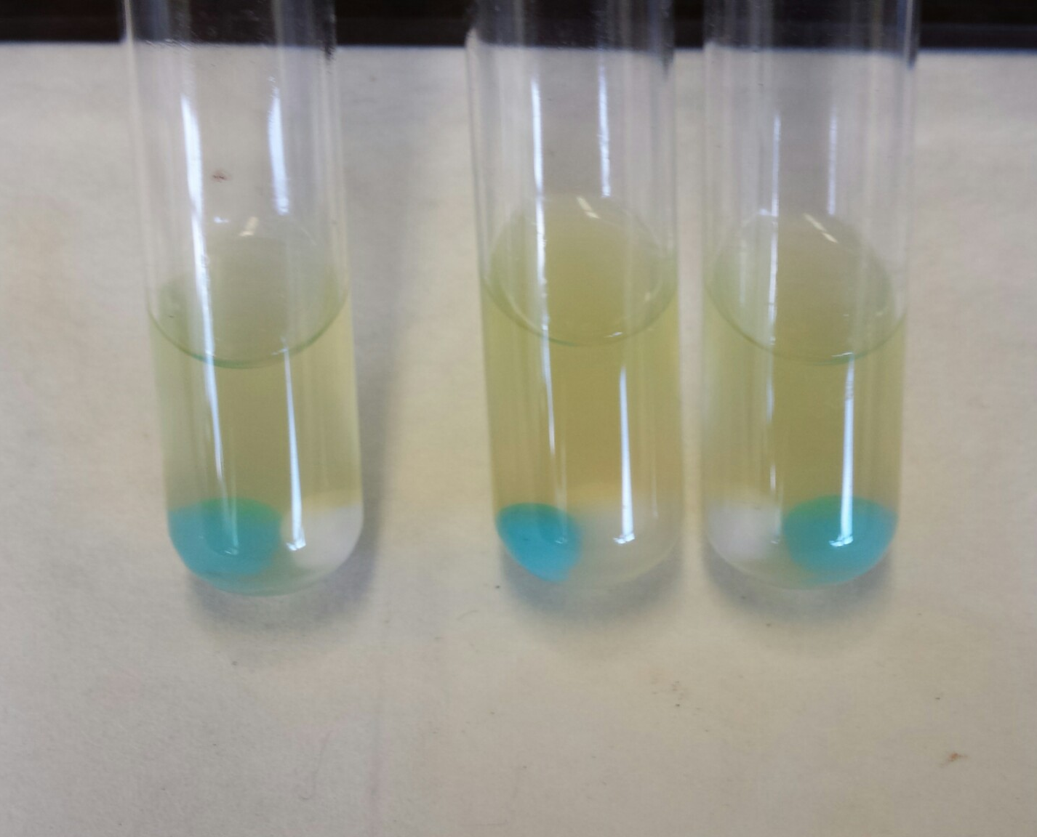
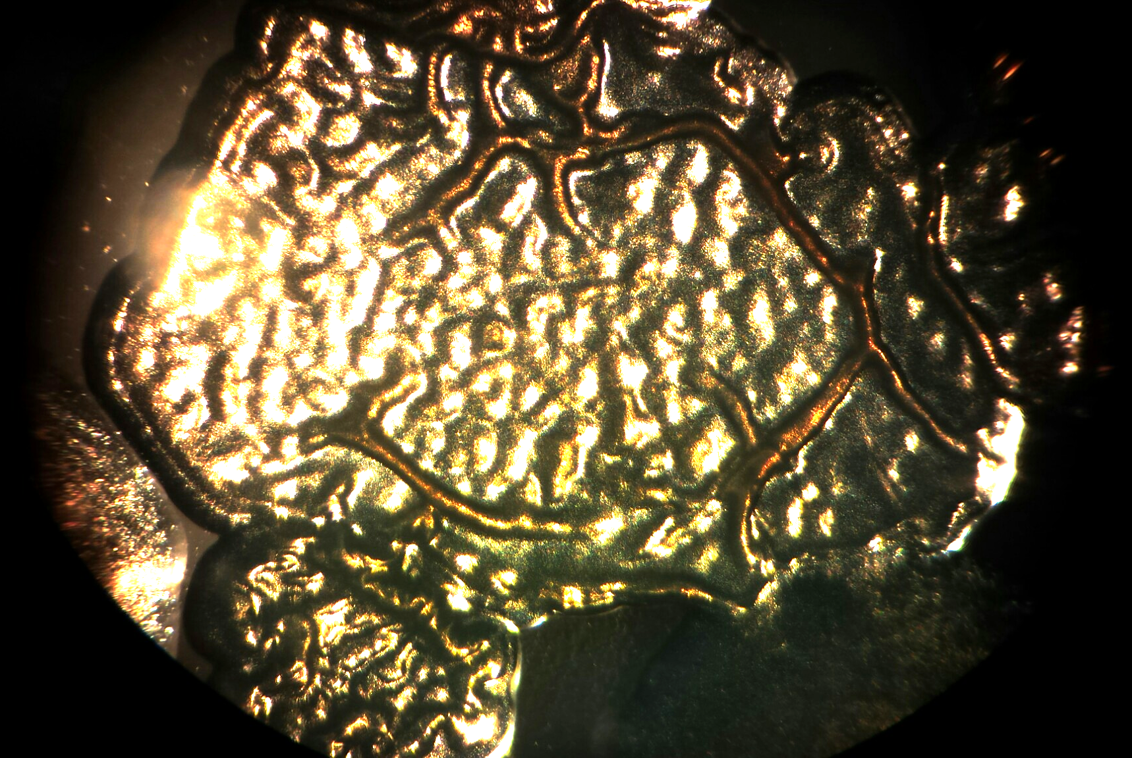
Teaching Evolution in Action
Students learn microbiology lab skills, and have the opportunity to see organisms change in the course of a week long activity
Notes:
Tonite, we are going to walk through a great hands on activity for teaching components of the topic of evolution in the classroom. This phrase alone conjures up many different images for every person in the room. One of the most difficult things about this topic, for me as a teacher, was how intangible it can be for students, and how many misconceptions there are associated with the topic. The presentation is a hands on approach to a lab, and we will present a mix of what do you as the teacher need to consider if you want to take this activity home, and to have you be a student for part of the experience. Our goal by doing this is so that you can experience the process and have a chance to ask questions that hopefully will help you teach this and consider it from your students perspective. For some this may seem a complex procedure, but there is a repetition once you get in the groove. Slide color coding (green = student actions; purple = teacher background info)
The packet is a quick look at some of the materials we have developed and includes: have teacher information on the first 5 pages, examples of student lab sheets on pages 6-11; An NGSS connections chart following page 11; the equipment list, and lastly your lab sheet for tonite as the last page. We are going to start there, so, if it makes it easier, please feel free to rip that last page off :)
We are going to give you an overview of a project that we think is very worthwhile, and can be a great addition to your classroom ----- if you are ready to jump in.

Slide 2
Our Goals today:
Today we are going to give you a chance to practice the key skills that will help make this lab activity more successful in your classroom.
A glimpse of the big and small picture of this project as it relates to your classroom
Contacts and how to get materials, and teachers who have done this in their classroom for support ideas.
What will you leave here with:
Notes:
We would like to lead you through this as a student first, and then take the teacher questions re: implementation later please bear with us as we go. Our big goal is that more teachers feel like this is a protocol that they can access and feel good about its use in the classroom.

Slide 3
Our recommendations
When you do labs with students, what is your focus?
- Procedure and lab skills
- Concepts and analysis of results
- Inquiry/ design/ and possible mixed results
- A glimpse at how long it really takes to do authentic research on major scientific topics
Start with what works best for you, then build as you go
Notes:
This activity has a number of complexities. It is our belief that taking the time to do this experiment with your students will offer a cornerstone to many topics covered in biology classrooms with visual results that the students were part of, and can see how diversity occurs in a short period of time. It offers many teachable moments about how important it can be to follow a procedure and develop good lab skills, or how all of the knowledge material relates to actual research science experiments that can be done by students; Maybe you prefer to operate from an inquiry approach - and are experimenting yourself with a blend of gently guided to full inquiry. This procedure can be used to hit many points and engage students in authentic experiments with respect to evolution at an organism level and tie the information into many other topics or specific fields of scientific study.

Slide 4
Problem Statement: What key variables prompt change at the organism level?
Clarification: for this experiment we will be using Pseudomonas fluorescens a single celled organism that have a tendency to form biofilms. LacZ+ and LacZ- (related to a gene product that is known to produce metabolic regulatory processes in the cytoplasmic membrane.)
What evidence would we need to confirm that an organism has changed and evolved?
Based on these ideas, List all possible variables on your lab paper, that might be related to growing bacteria that would allow us to see change?
Notes:
Refer to lab sheets in back of student packets -
Pseudomonas is a large class of biofilm builders, a gram - aerobic bacteria, rod shaped, flagellated. They are easy to culture, and inhabit a wide range of niches in our world. Some you may have heard of before: P.aeruginosa ( biofilm builder in the lungs, lowered immune system, human pathogen); P. syringae is a plant pathogen; a number of Pseudomonas strains are being used in bioremediation of environmental toxins; some we use to culture foods we eat; and P.flu typically is found in a symbiotic relationship with beets/Plant roots as a fighter of other pathogens. Pflu has been used in burn wards to treat MRSA as it produces its own antibiotics.

Slide 5
Pre-assessment
Let’s take a moment to look at one possible option for how to determine where your students are on the topic of Evolution, Natural Selection, and related ideas.
Questions were modified/ adapted for this doc from the AAAS site
Notes:
Ask participants to answer out loud, or jot down notes for later.
The intention of the pretest is to evaluate student misconceptions, and find a way to quantify that information before starting the experiment. Teachers use these tools for a variety of reasons, for this particular topic, it is useful to evaluate before and after knowledge of depth of understanding, as well as any changed answers after the experiment.
Identifying student misconceptions based on the key concepts of Evolution/ natural selection and where students may be in the continuum of naive vs experienced, were considered in the development of those questions. There is research that suggests it is equally important to identify students who are in the process of changing their understanding - there are some answers on the pre-test that allow for a mix of understanding or confusion. The other common misconception for students on the topic of evolution is causality, there are questions that offer students a chance to clarify for themselves what the cause and results are in the process.
The questions have an intentional blend of the key concepts related to replication; variation; selection as well as definitions. There are two questions that allow for open ended responses, that should be short sentence but long in ideas. In order to explain a complex idea in a single sentence requires the students approach their answer from an analysis perspective.

Slide 6
What do you need to know to design an experiment?
Your packet includes parts of the information that was intentionally designed to align with NGSS.
-Background information
-A list of materials needed for activity
-Student and teacher protocols, assessments
- A method to get results students can analyze, etc
Depending on your experience as a teacher, supplies provided by your school, and students reading level there are many options in how to approach this protocol.
Our task at the onset of this project, was to take a research based protocol, used only in a small setting with university and expert support, and turn it into a user friendly model for high school students. This included recommendations for lessons, background resources, connection to NGSS standards, assessments, student lab sheets, teacher answer sheets.
Which is what brings us here today.
Notes:
These are items that are part of the digital package, contact Matt Heron for access, and reference your attendance at this workshop

Slide 7
On your Lab sheets:
Students should read the background information and lab sheet protocol before they Write a hypothesis based on a 5-7 day procedure given the information just shared. (refer back to the problem statement and variables to address the focus)
Methods: on your lab sheet we have broken up these steps based on stations you will visit.
Please feel free to make notes at each station re: things to remember for your work with students; questions about why; or how you would improve this process for use in your classroom.
We will have a question and answer time at the end of the practice sessions
You already have the problem statement
We have listed variables - confer with your table groups to make a complete list
Identify which is the IV, DV and controlled
Make a list of predicted outcomes based on your current knowledge of single celled organisms/ biofilm builders
Here is what else you need to know:
Length of experiment
Growth Media with bead transfers,
Followed by a dilution series
Alternate day Plating
Notes:
Refer back to your lab sheets, and the lesson protocol in your packets: here is a brief overview of the experiment. Depending on your students previous knowledge, you may prefer to do this as open inquiry with use of a standard protocol, or guided inquiry. Options for students to wander off the standard protocol are available and supported by the research, those options are obviously up to you and your comfort with the protocol and experience of your students.

Slide 8
Design a procedure based on your Variables and evidence constraints:
What we have provided:
This activity offers a starting point, in which teachers and students can develop further inquiry approaches once they have the foundation of methodology and typical results.
What the protocol offers (controls) :
Controlled process for testing
Organisms normal requirements
Repetition of daily procedure
Background information to connect results to mechanism of change
Method to gather consistent results
The Inquiry extensions:
- student focus on specific questions based on research and results
- modification of sample selection by lab groups
- modification of solutions for carbon source

Slide 9
Stations to practice
Station 1: transfer Pflu from growth plate to 1st evo tube (Day -1)
Station2: sterilization methods (test tube open/close, bead transfer, etc)
Station 3: post bead transfer, dilution series practice (Day 0, 2, 4)
Station 4: plating dilutions and sealing (Day 0, 2, 4)
Station 5: reading/ recording results
Please visit and try each so you can make notes for your own use in the classroom
Notes:
Doing is all part of the plan; please plan on trying each of the stations. We will take about 20 mins to rotate around stations, before gathering back to wrap up this workshop. Days of the protocol repeat, so learning the progression and skills will help class time and discussion facilitation rather than being overwhelmed by simply protocol. Even days tend to be the more complex days, while odd days of the procedure offer time for discussion and tying in teachable moments, or major concepts.

Slide 10
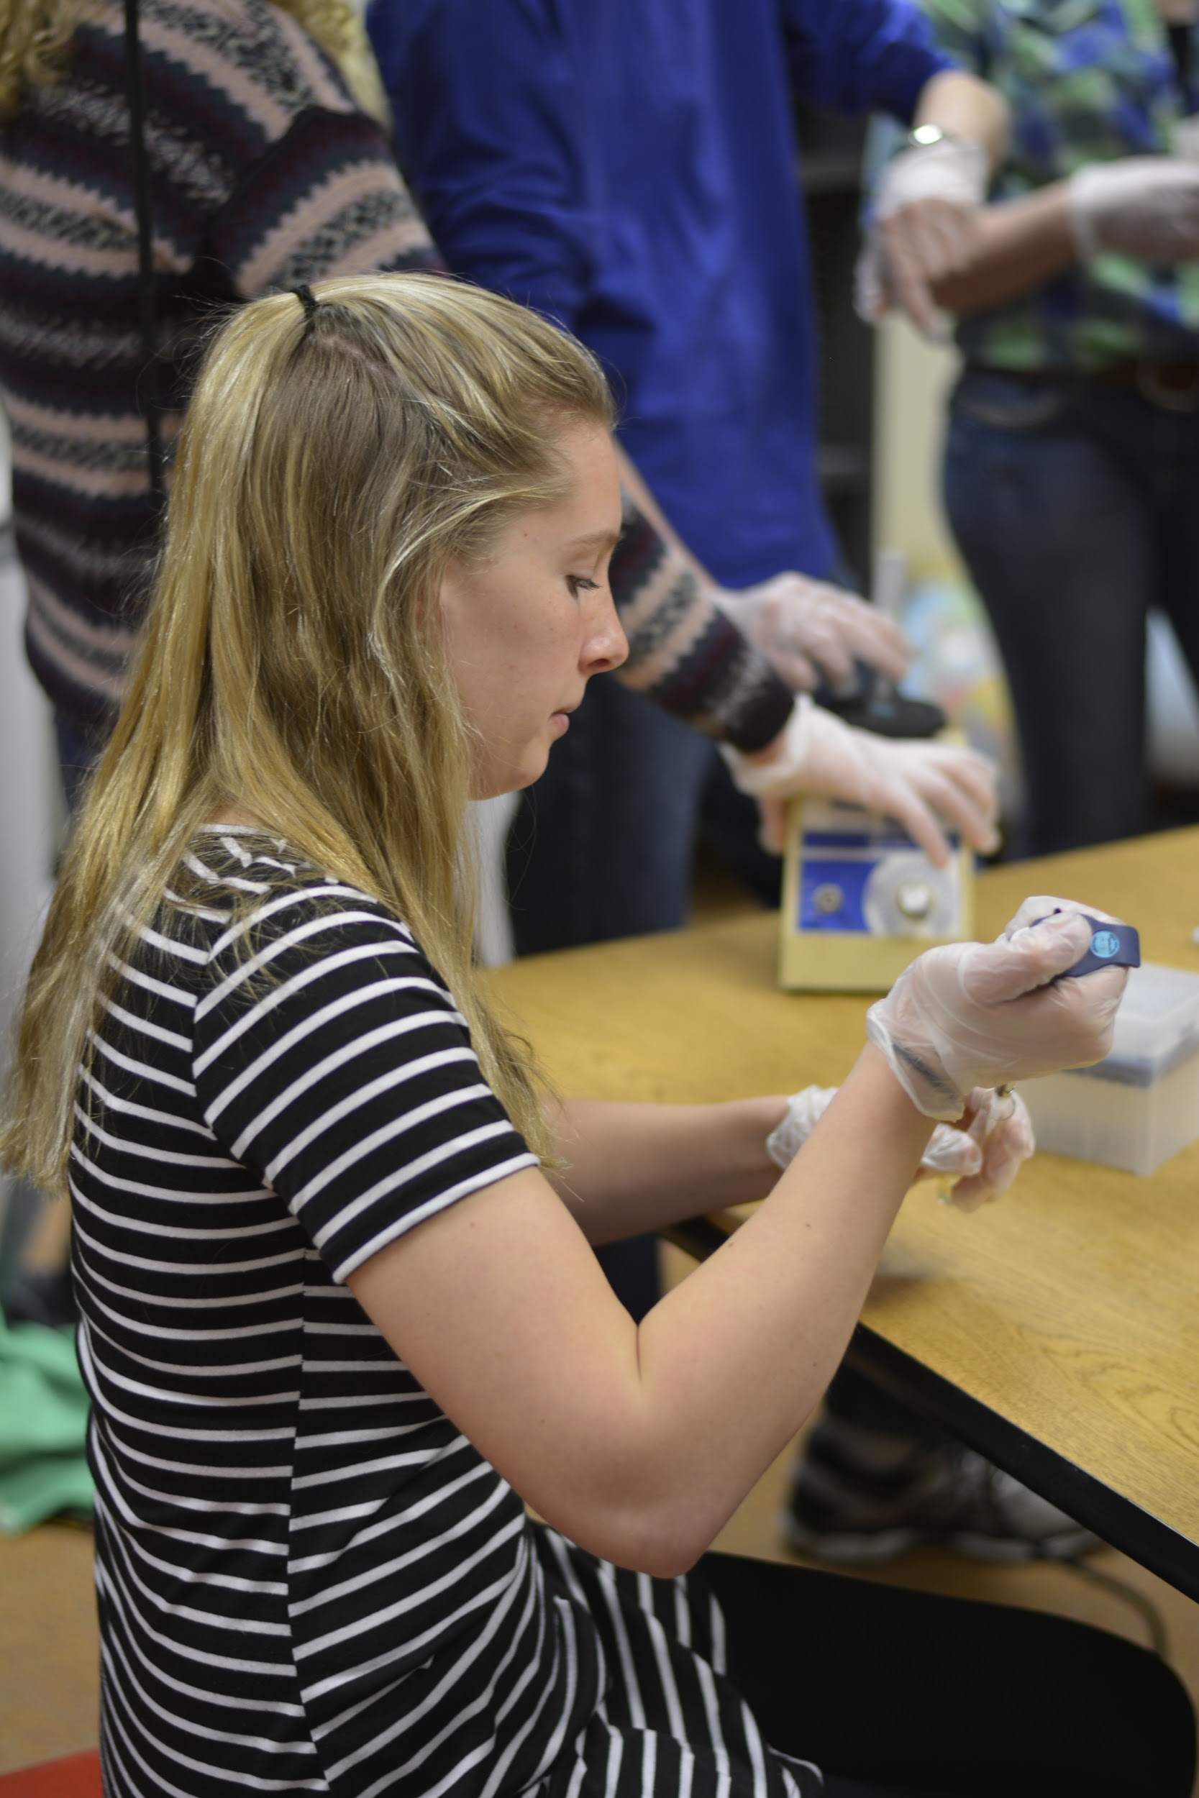
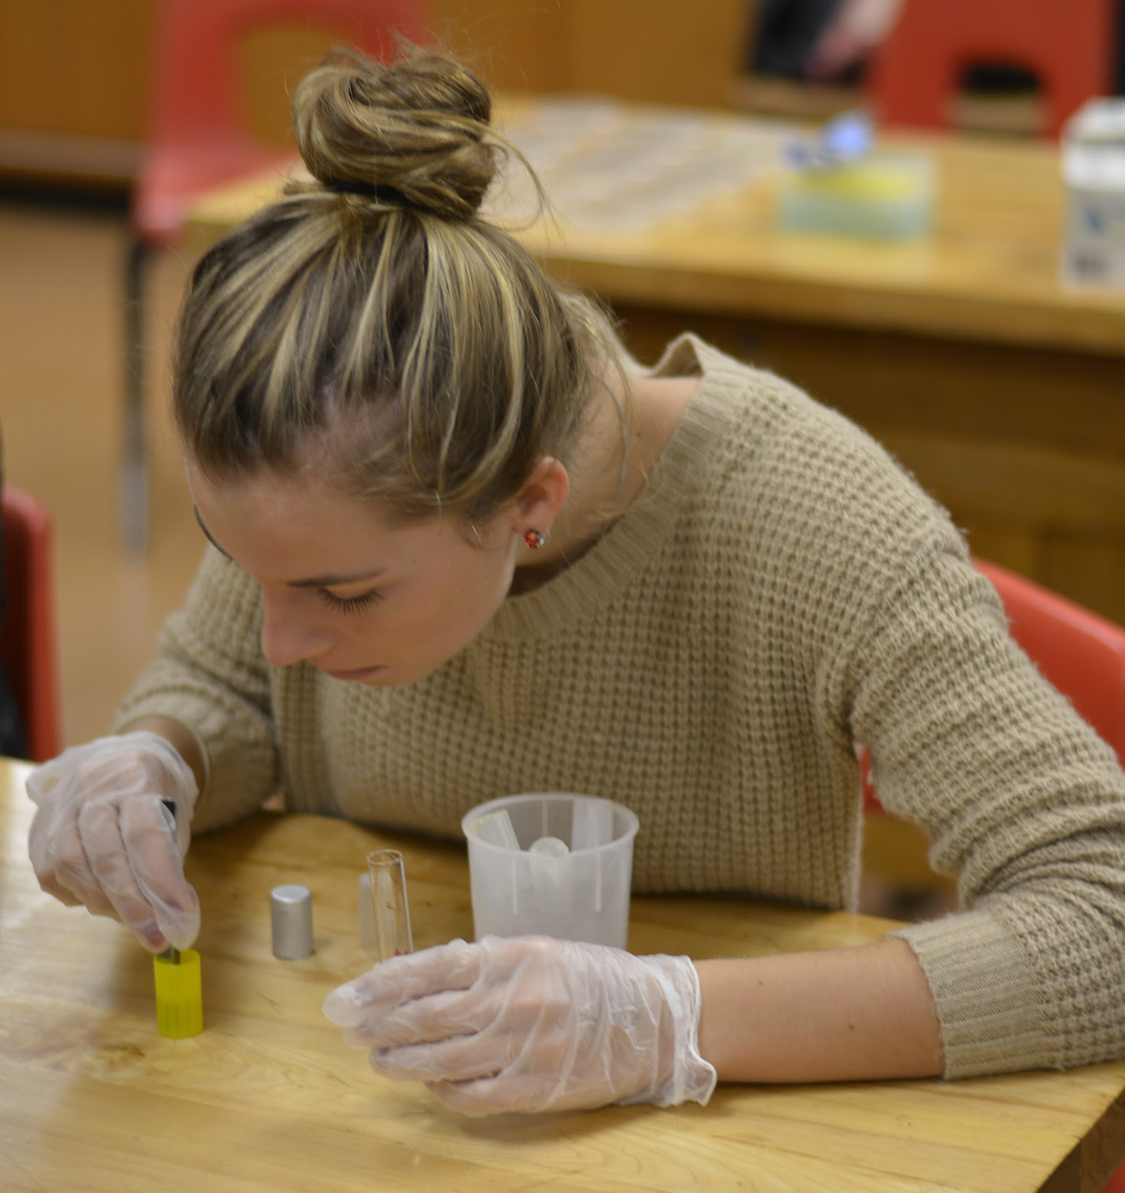
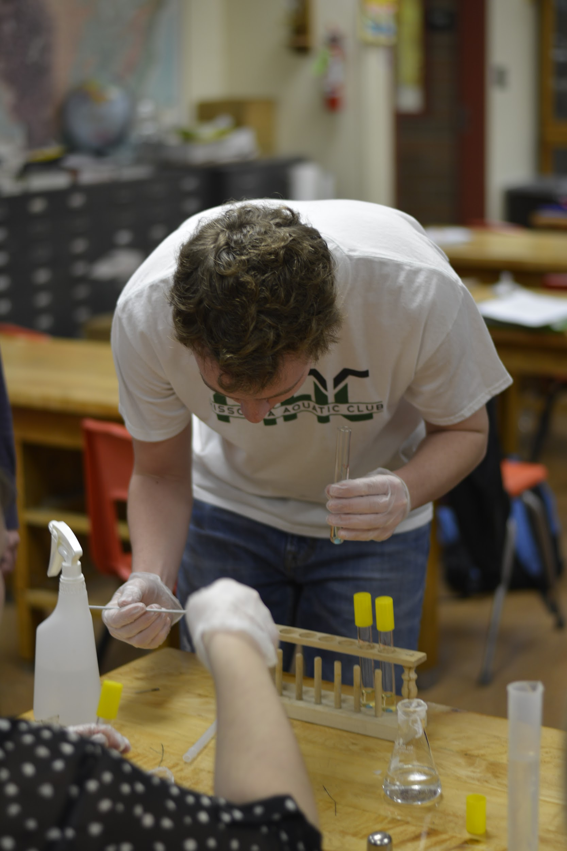
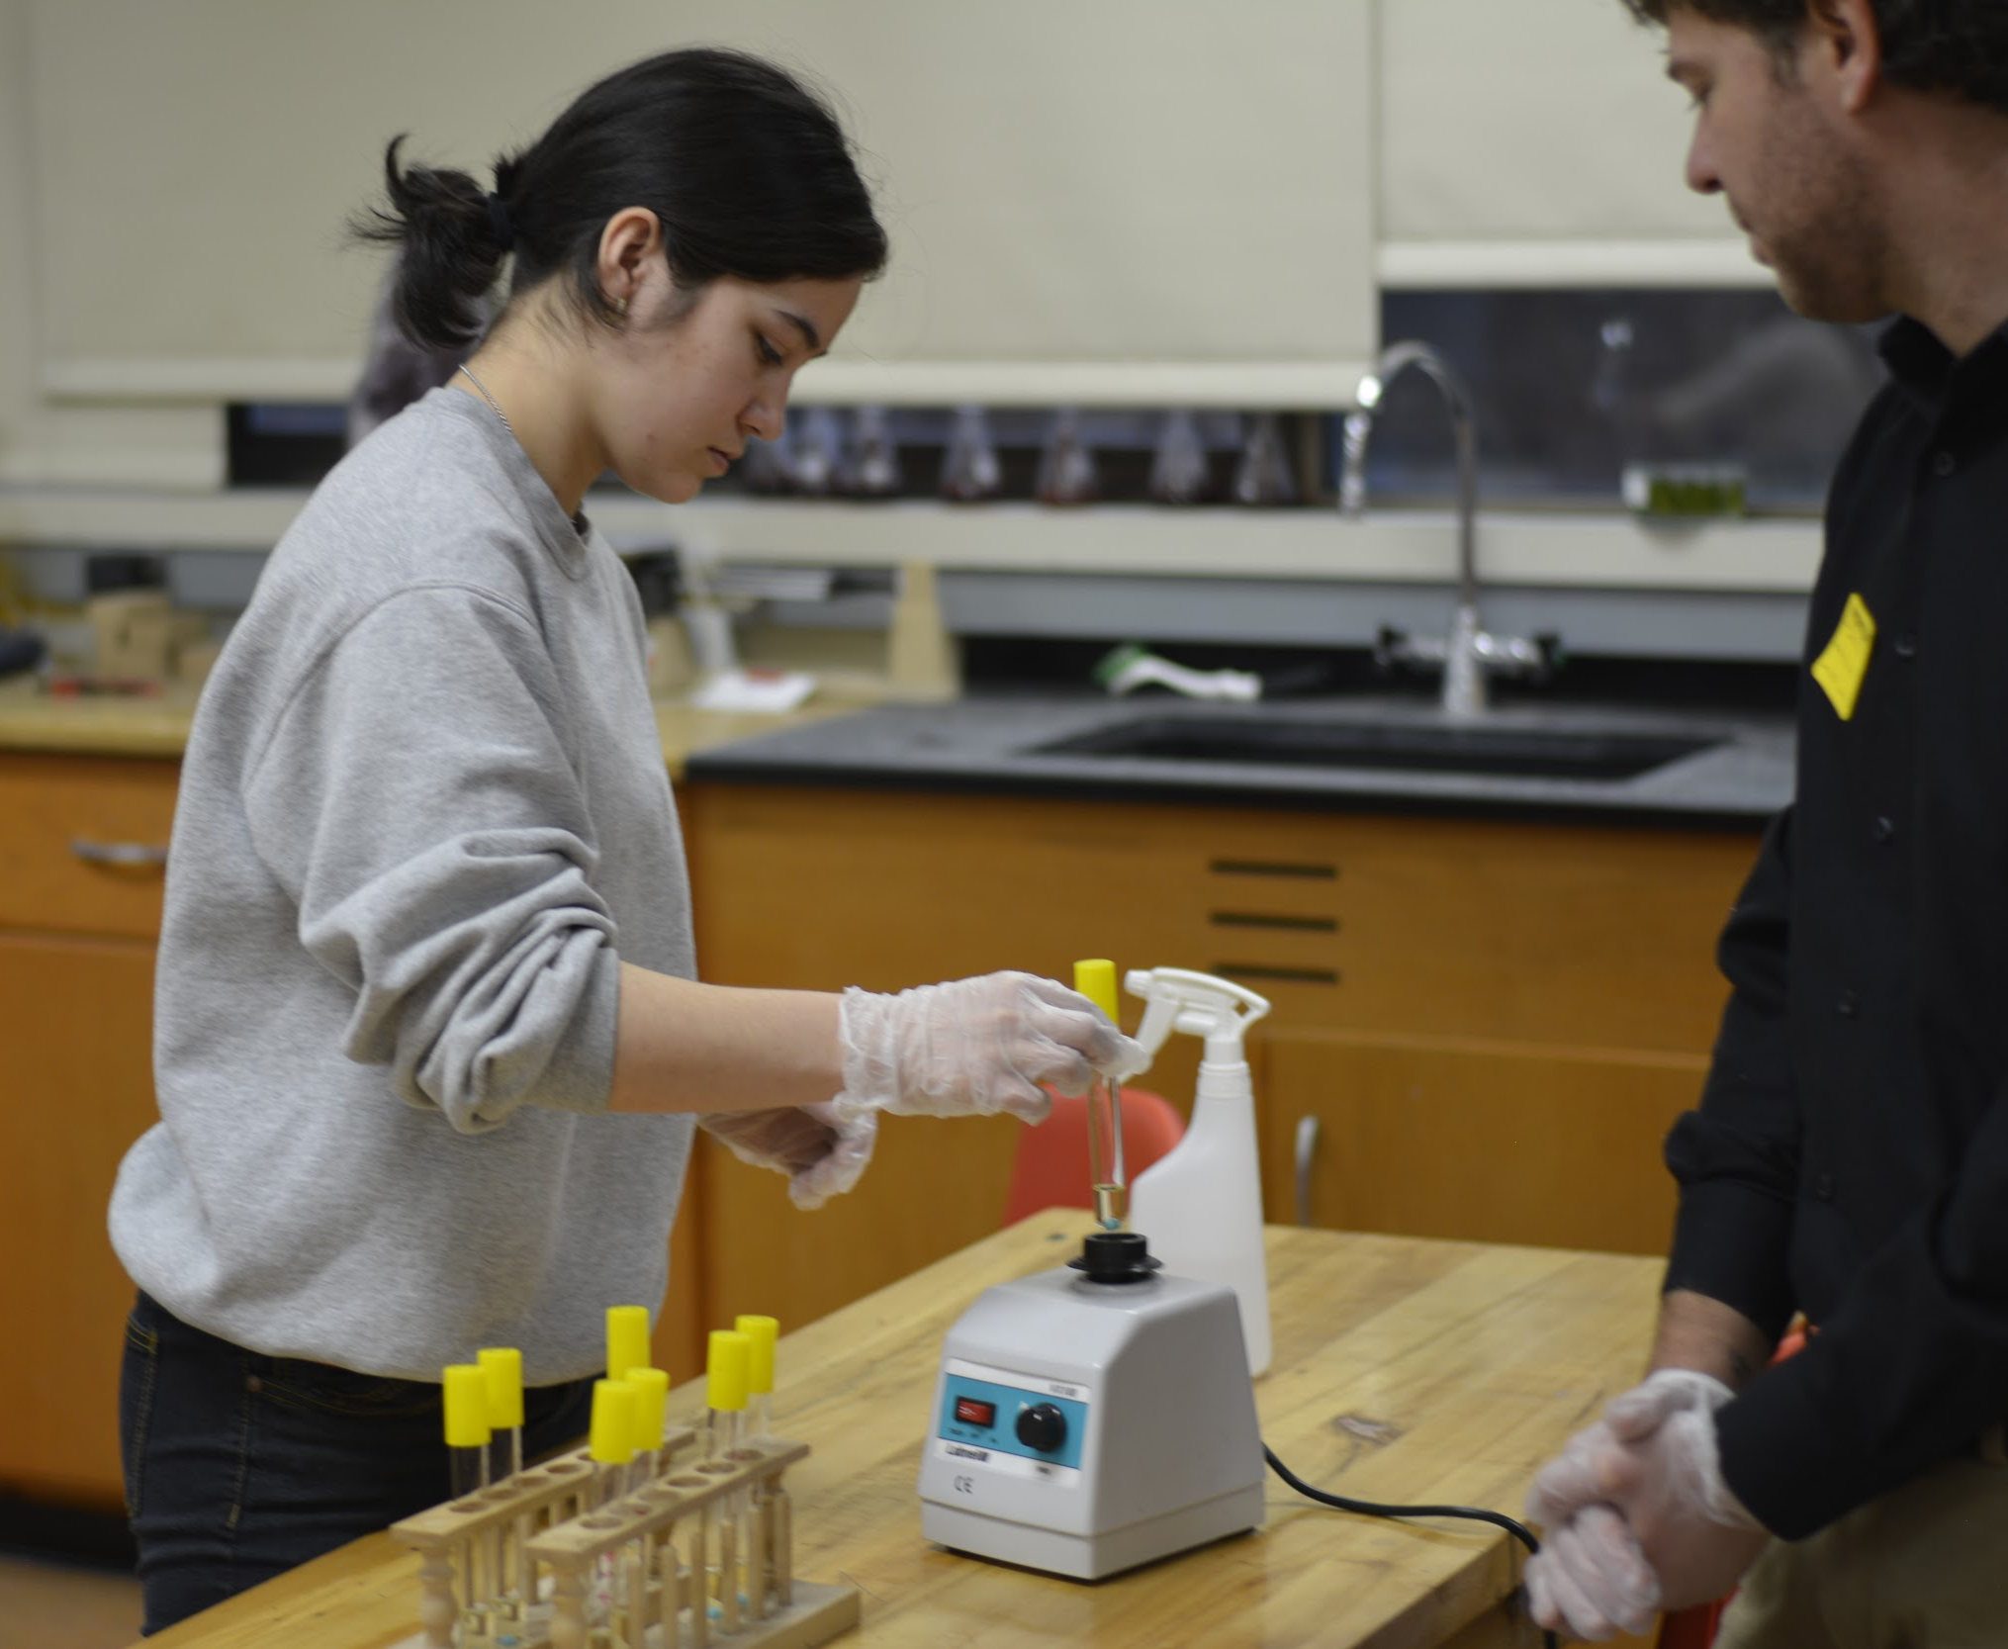

Slide 11
And NOW…...
Videos can be useful resources, here are a few that relate to this lab. Here are some available on Utube:
Series dilution
Aseptic technique
As you move among the stations, keep in mind the experiment has an order, but you are free to go where ever best meets your needs.
Please jot down questions you have as you go. We will end with a question/answer time, as well as our experiences with this project.

Slide 12
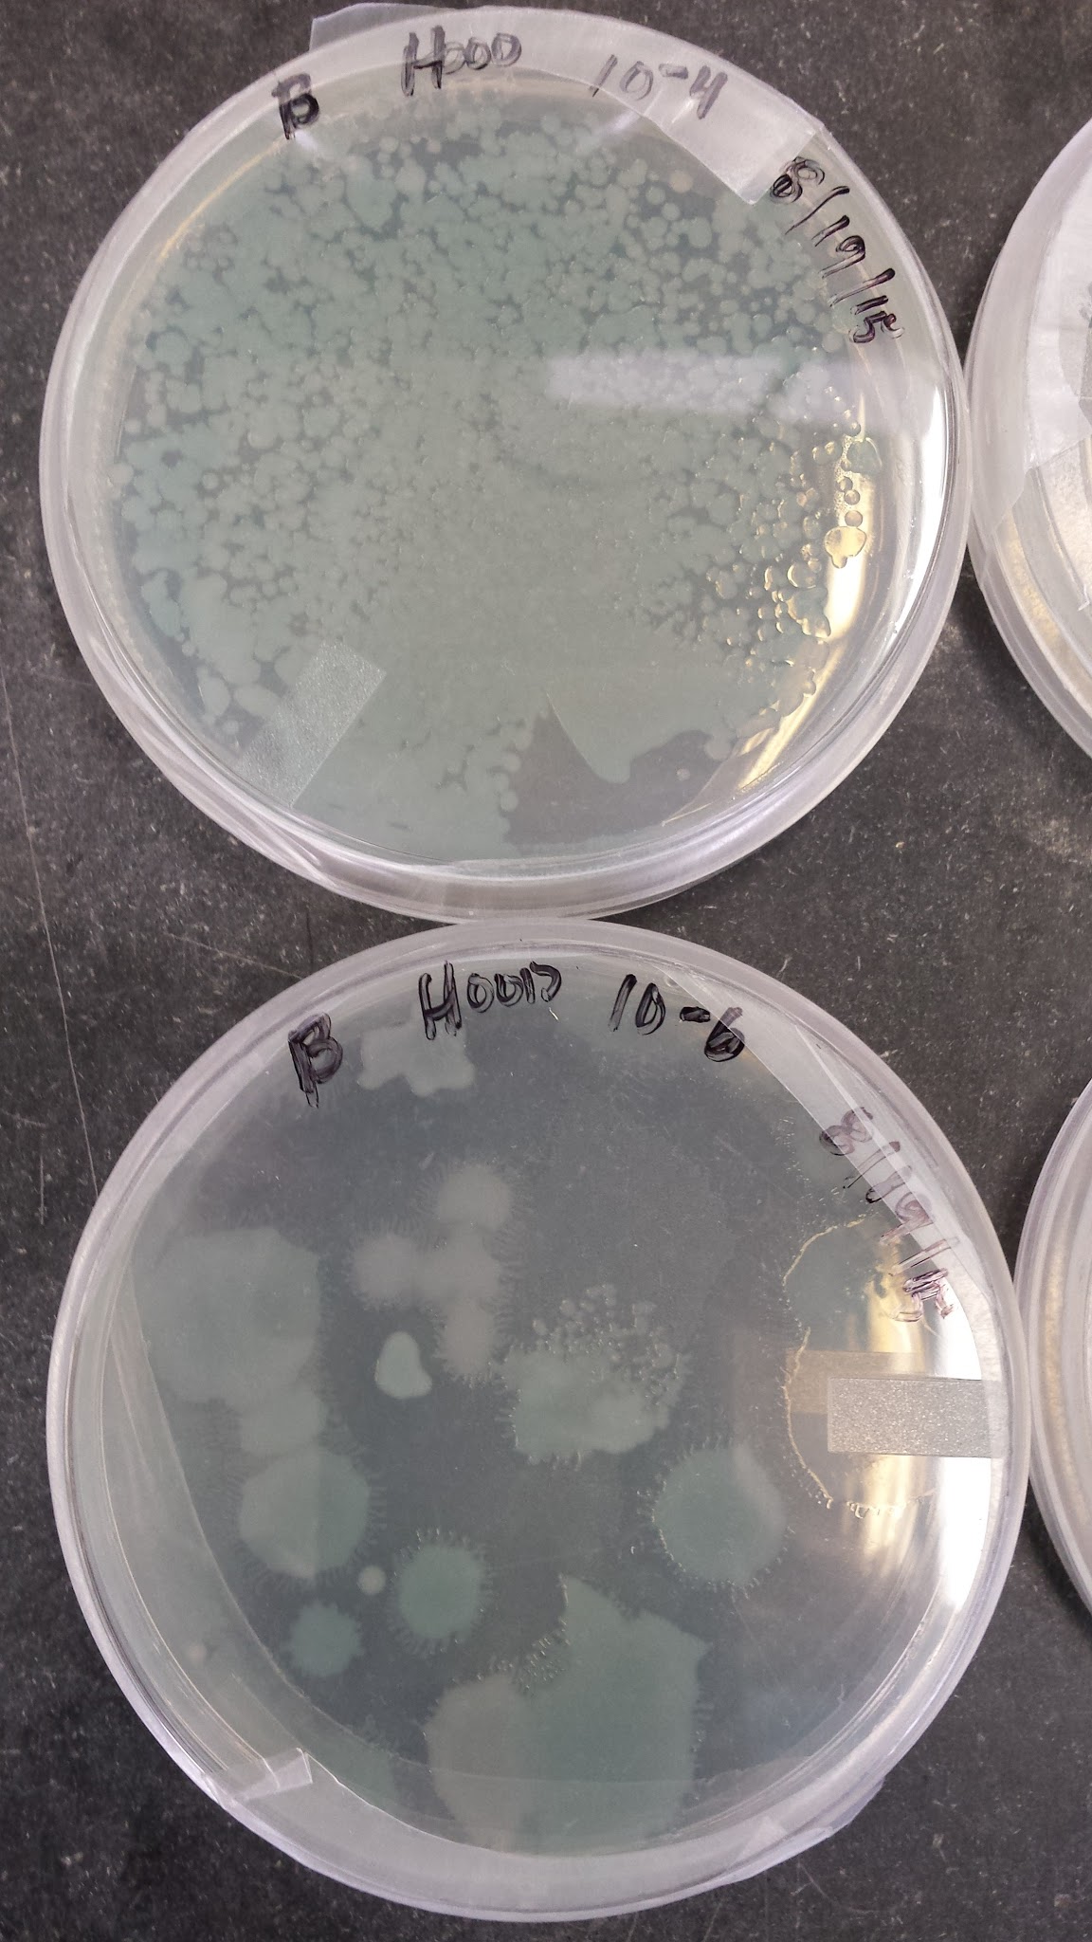
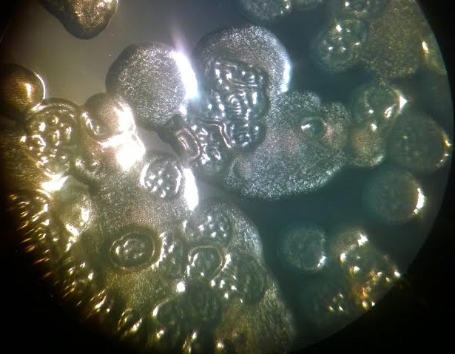
What to expect:
As in all science endeavors, there will be times that things work perfectly. There will also be times when, ……
Are you the teacher that considers that a teachable moment?
Notes:
Refer to what was great, what was a surprise, and what did we learn (condensation on plates, smaller aliquots, variety of morphology, selection of too large specimen from original ancestor plates, etc) All great things to discuss, and have students analyze their methods, and how it still all relates back to normal in the world, normal in science.

Slide 13
How to improve success:
Focus the procedure on the portion you are most invested in the students understanding:
- Procedure and lab skills
- Concepts and results
- Inquiry/ design/ and possible mixed results
- How long it really takes to do authentic research on this topic
If you are not familiar with microbiological procedures - practice them before presenting to your students (show a video, have someone demo while you explain the process to students)
Give students a chance to practice a dry-run before working with the real organisms

Slide 14
Microbiology in the High School classroom:
Concerns and solutions:
Length of project and effectiveness of meeting the standards
Access to materials **
Awareness of developmental stages/ skills of students
Use of the teachable moment that allows for more growth and questions leading to more depth in the topic.
Our goals:
To make this procedure accessible for use in the high school biology classroom
Materials
Procedural changes
time/ length consistent with end results or student learning
Notes:
In upper division science classes, this can be a foundational process in which many topics are covered. For example the timeline of Evolution as a conversation goes much further back than most students understand, as far back at 300 BC. (Zeno, Epicurus, Al Jahiz, Augustine, etc)
Conversations about evolution of single celled organisms, from early protobionts to current cell structures and differentiated functions, which then leads to RNA and DNA conversations, reproduction/ replication issues (translocation, deletion, insertions); classification, diversity.
So many topics can be covered before, during and reflected back on from this particular lab as a foundation.

Slide 15
Where can I get these materials?
Matt Heron lab - digital materials, access
Equipment: Carolina Biological; Flinn Scientific
Unique materials: styrene balls; Xgal for colormetrics
Autoclaving is key to this protocol for best results. This is the one protocol that is mentioned in the teacher support materials, and not seen in the student pages, or sterilization protocol.
Our dream was to make a trunk:
Go looking in your department store room and see what you can find.
If you want the digital materials:
If you need to go shopping:
Notes:
See the materials list in your notepacket

Slide 16
Credits
Research grant awarded to:
Frank Rosenzweig labs (UM and GA Tech)
Matt Herron (UM and GA Tech)
Gwen Nix, UM lab tech
Jared Betz, RL Boyles, Ellen Parchen- teachers
Original protocol and support from Vaughn Cooper Labs
And Questions?

